Slide 1
Club Engagement Workshop 2023 Growing club’s statistics & The state of Membership

Slide 2
CONSISTENT & FLEXIBLE MEETINGS
76%
Meet weekly in person
65%
Use hybrid or virtual technology
29%
Created a satellite club as an alternative Rotary experience
Notes:
Explain the North American survey from club presidents whose clubs had year over year growth for the past 5 year.
What are they doing?
These clubs meet regularly and are flexible in their approach. Nearly 30% of these growth clubs have created a satellite club as an alternate experience for prospective Rotarians

Slide 3
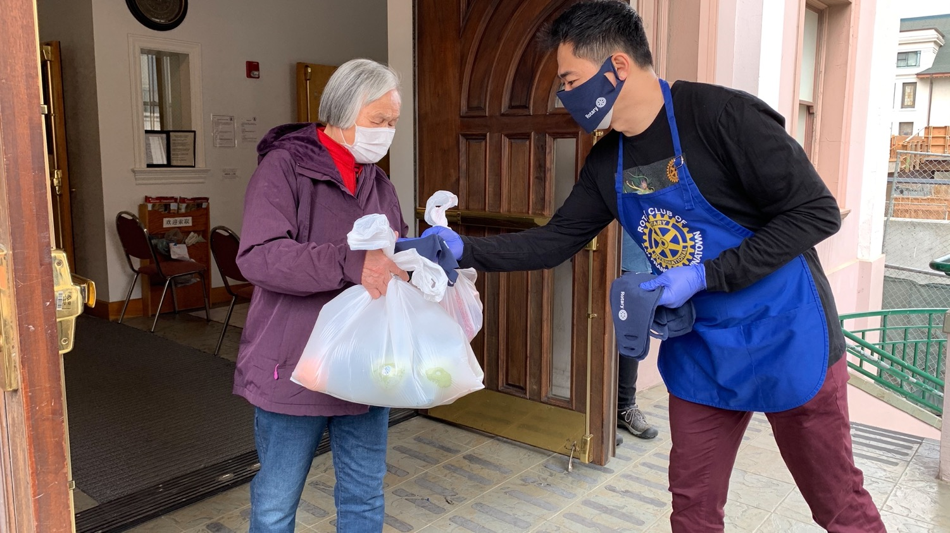
“SIGNATURE” SERVICE PROJECTS & FUNDRAISERS (>50% Member Involvement)
86%
Have a repeating ‘signature’ project every year
83%
Have a repeating ‘signature’ fundraiser every year
Notes:
Read Slide

Slide 4
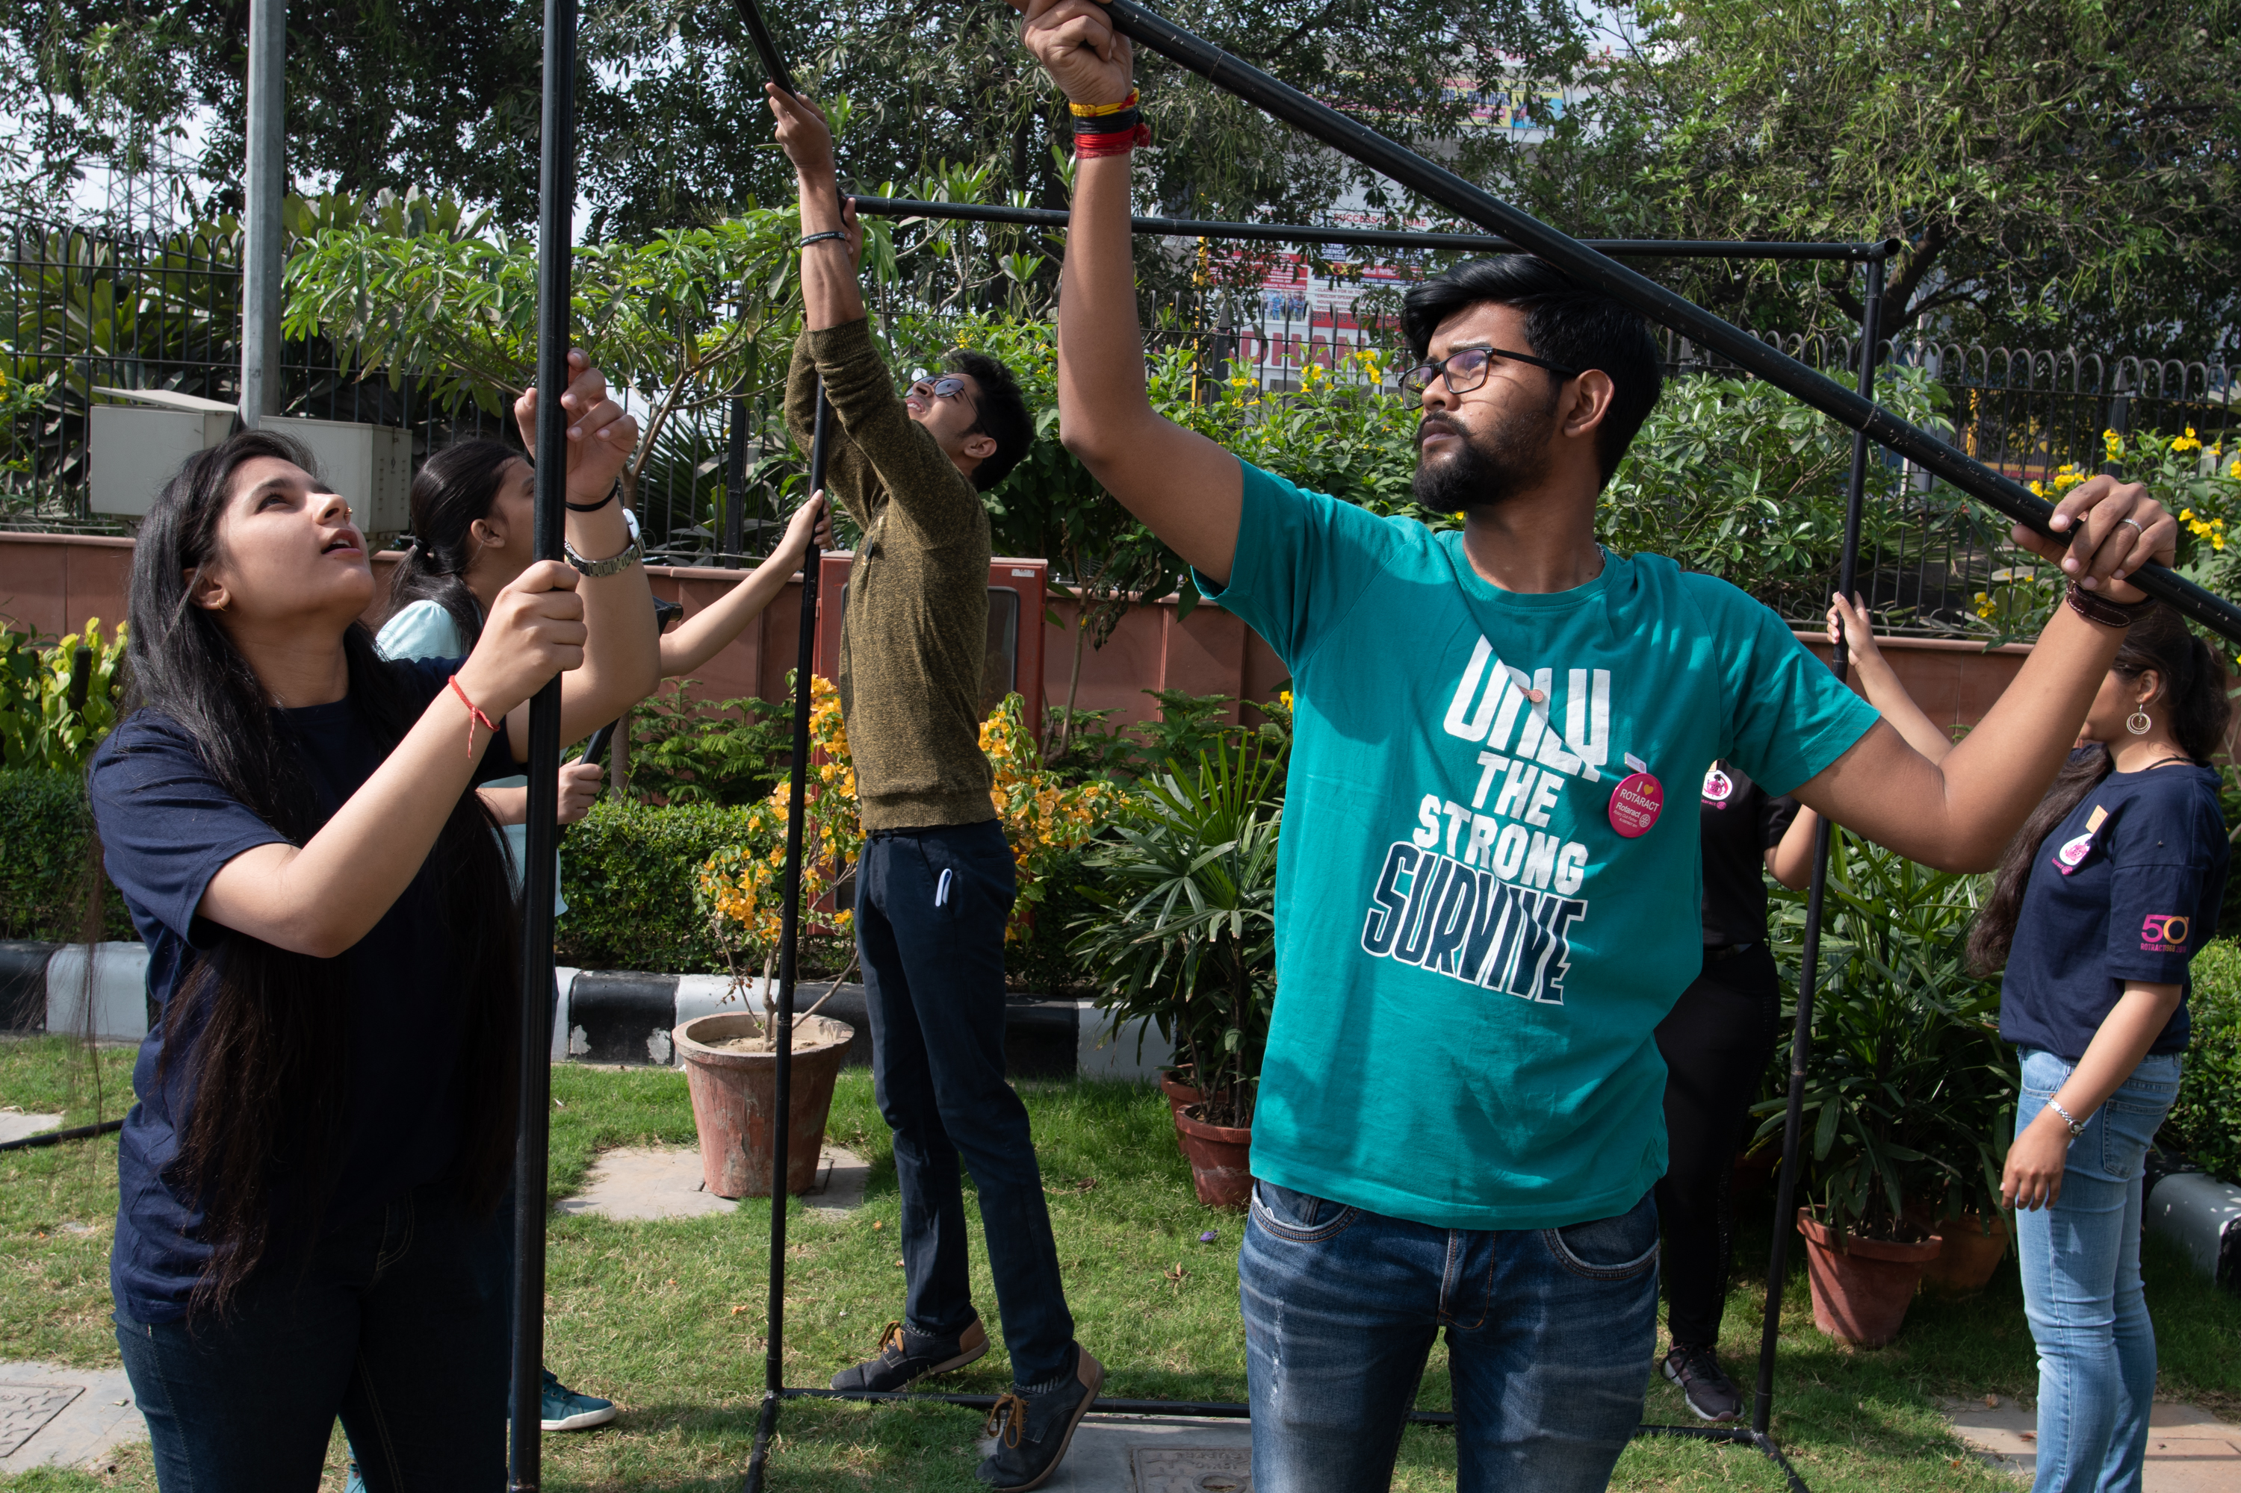
INCLUDE COMMUNITY MEMBERS
“The Secret Sauce”
87%
Invite community members to projects and fundraisers
67%
Hold one or more events to attract new members
Notes:
We can’t emphasize strongly enough how important the act of reaching out to the broader community is to creating the perception of a dynamic, attractive and welcoming group of people. As we quote from the survey. It really is the secret sauce, creating opportunities to engage and inspire ‘not yet Rotarians’.

Slide 5
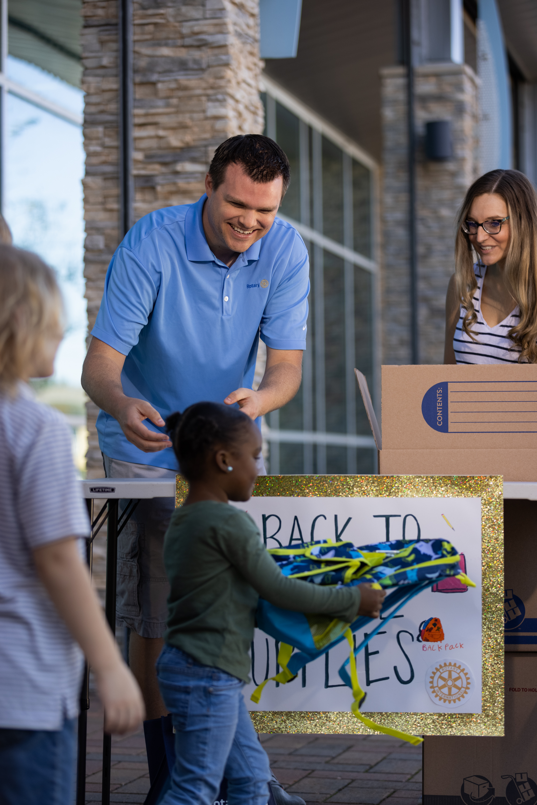
ONGOING, ACTIVE SERVICE
78% Had 4 or more Service Projects during the year
(40% had 10 or more)
Notes:
These clubs have frequent service projects. Only about 20% of the clubs indicated tat they only have a few service projects. Nearly 40% of the clubs have more than 10 service projects per year. Lets hear club leaders talk about service.

Slide 6
ACTIVE USE OF MEDIA TOOLS
95%
Use Facebook
21%
Use Instagram
77%
Use Their Club Website
55%
Use Local Print News Outlets
Notes:
Read Slide

Slide 7
USING PUBLIC AWARENESS TO FOCUS ON MEMBER ATTRACTION
67%
Hold events to attract new members
77%
Many members sponsor new members
87%
Invite community members to projects
Notes:
Read Slide
Now, club leaders will talk about their approaches to public image in their community.

Slide 8
ATTRIBUTES OF GROWING CLUBS
ACTIVE, INTENTIONAL MEMBER ENGAGEMENT
DYNAMIC, MEANINGFUL SERVICE
EFFECTIVE GOVERNANCE (Intentional Leadership)
STRONG PUBLIC IMAGE
(WELL KNOWN IN COMMUNITY)
DIVERSITY, EQUITY & INCLUSION
Notes:
With the data from the first survey as a key basis for inquiry, we were able to seek more detail, with the result that our understanding of the qualities that make clubs successful was enhanced, clarified and expanded:
First, and most importantly, strong leaders create strong clubs. More than this, leaders of surveyed clubs focused on 5 key attributes, which we will explore in more detail:
Outstanding governance – clubs are well organized, plan, set goals and have continuity in leadership.
Active, intentional member engagement – A healthy, engaged and inspired membership is key to club success.
Dynamic, meaningful service – engaged members keep busy ‘doing’ throughout the year. Rotary is about service.
Strong public image – Clubs aren’t just doing – they’re seen to be doing.
Diversity, Equity and Inclusion – ensuring club membership reflects their community
While not all leaders focussed equally on all 5 areas, most clubs take all these areas seriously.

Slide 9
THEY PLAN FOR GROWTH &
SET GOALS
81%
Have a Planning Process for Growth
71%
Regularly Updated Growth Plans
Annually (48%)
Quarterly (16%)
More Frequent (7%)
83%
Established Annual Membership Goals
Notes:
The significant majority of clubs don’t just plan and set goals, they keep those plans alive and up to date, reviewing and adjusting regularly.
.

Slide 10
Using the membership success tool
Notes:
The reality is, in this last Rotary year, almost half of our clubs added 0 or 1 new member. To overcome the natural attrition, we MUST attract members to our clubs. What if you could go into a Rotary year with a pretty good idea of exactly how many members would leave over the year so you knew how many to add to have positive, net growth? The good news is, we now have a tool to help us with that.

Slide 12
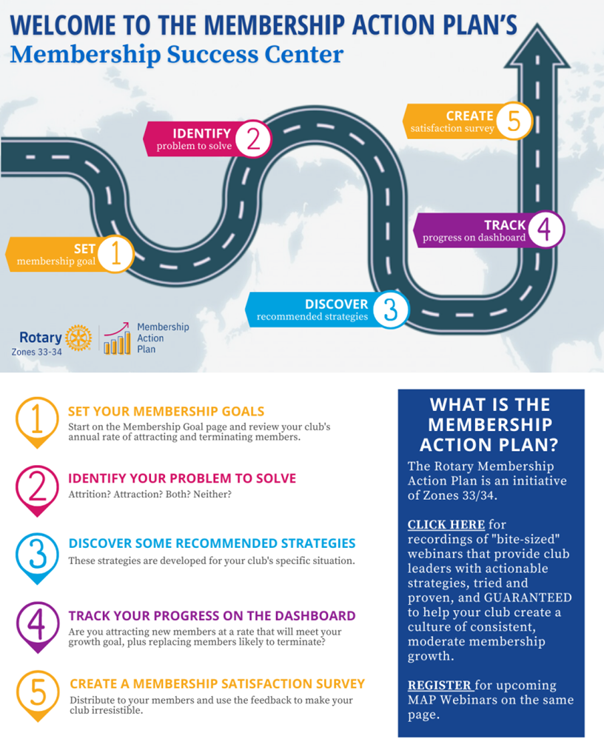
Membership Success Center
Notes:
This is a component of DACdb with feeds directly from RI. Don’t worry if you are a Club Runner District, there is a way we can get you access to this system as well
It starts with entering in the membership goal the club has entered into MyRotary > Rotary Club Central
Considering your club’s recent membership history, what’s a reasonable growth goal? Something in the range of 5%-10% is reachable for most clubs –
Just enter that growth rate in the goal setting worksheet. Alternatively, you can enter a numerical membership goal and the growth percentage will be calculated for you.

Slide 13
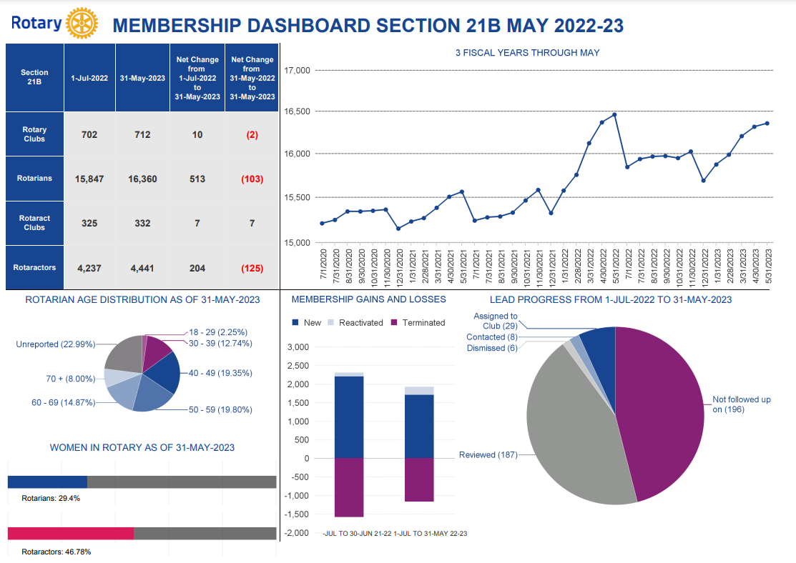
Zone 31
Notes:
Comparison from May 2022-May 2023
Zone 31 use in St. Louis and Tulsa
Make a few comments about year over year growth vs losses

Slide 14
What about new clubs?
Notes:
Like attrition and attraction with members, we are losing more clubs than we are starting.
In 2018 Zone 30 had 728 clubs and Zone 31 had 783. Unfortunately, in 2023 Zone 30 is down to 701 and Zone 31 761.
That’s a 3.7% attrition in Z30 and 2.8% attrition in Z31. So how are we doing with attraction?

Slide 15
What about new clubs?
Notes:
The good news is we have re-admitted some lost clubs which is usually an administrative issue for nonpayment.
As you can see our attrition is almost 2 x our attraction rate.
So, what can we do about this challenge?

Slide 16
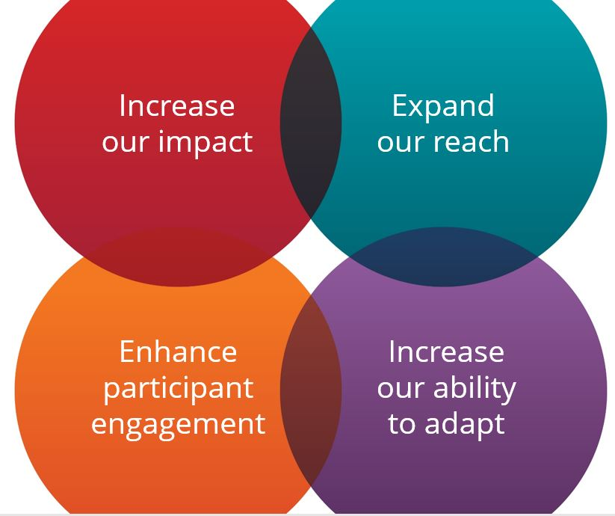
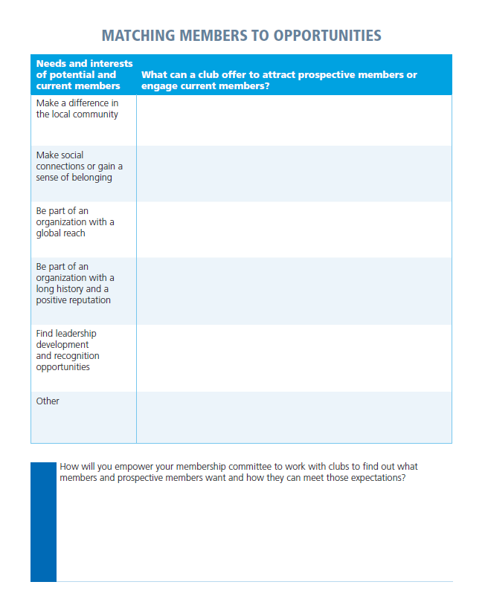
Exercise
What can a current, or new club, offer to attract and engage based on their interest?
Notes:
Let’s discuss how we can make our existing clubs more engaging and identify what a club experience my look like that would appeal to a variety of members’ (existing or potential) interests. We would like you to work in groups at your table on the exercise being handed out. This chart lists some needs and interests of potential and current Rotary members. For each need or interest, please consider:
What might attract prospective members?
What kinds of programs & activities could a club offer to engage current members?
You will have 10 min to work on this and then we will share what you have discussed
Facilitator – based on time have as many share as possible and then ask them to reflect on how their district can empower the membership committee to work with clubs to find out what members and prospective members want and how they can meet those expectations. Encourage them to share this exercise with their club presidents to help them identify opportunities for engaging members.

